Slide 1
Build interactive AI-powered web apps with Blazor & .NET
Daniel Roth
Product Manager
Microsoft

Slide 2
Build your first AI-powered Blazor app
Agenda
Add AI features with .NET Smart Components
Leverage the .NET AI ecosystem

Slide 3


Access AI directly from the server with Blazor
Semantic
Kernel
WebSocket
Blazor
AI Model

Slide 4

Reusable AI-powered Blazor components
Semantic
search
________________________
Chat UI
The refund policy is located| at https://example.com/refund-policy
Text suggestions

Slide 5
Demo: Get started with Blazor & AI

Slide 6
.NET Smart Components
aka.ms/dotnet/smartcomponents
Smart Paste
Smart TextArea
Smart ComboBox
Fill out forms automatically using data from the user's clipboard.
Suggest whole sentence autocompletions based on what the user is currently typing.
Search through listed items using semantic matches.

Slide 7
Demo: .NET Smart Components

Slide 8



.NET AI ecosystem

Slide 9
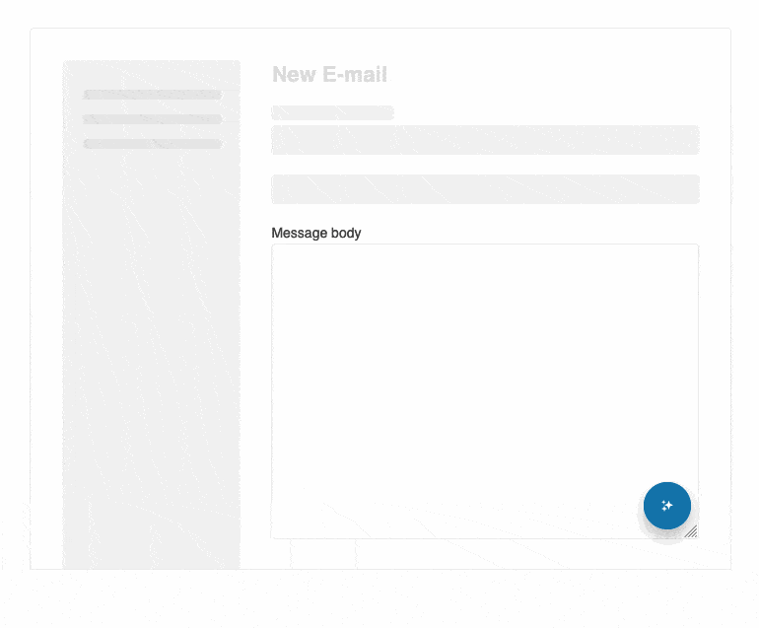
AI Prompt component – Blending AI with UI Available NOW for Telerik .NET MVC & Blazor
Created to streamline the integration of your favorite GenAI services into your apps
The component sends prompts from the UI and then maps the responses back to the UI
Enables three predefined views to interact with:
Prompt,
Output
and Command
Fully customizable with templates and events
Globalization and Localization
Right-to-Left (RTL) Support
telerik.com/blazor-ui/ai-prompt

Slide 10
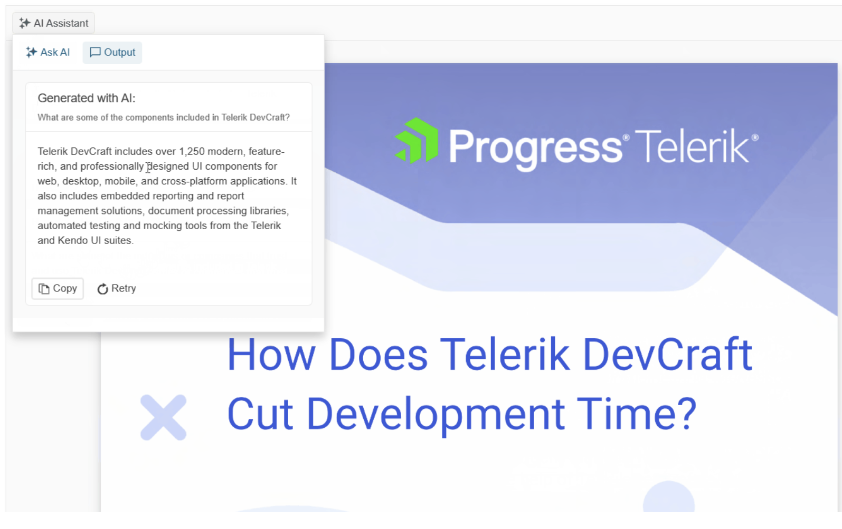
Experimental Smart (AI) Components 🧪
Telerik UI for Blazor & ASP.NET Core
AI integration:
Contextual Grid Smart (AI) Search
Contextual ComboBox Smart (AI) Search
PDFViewer with Smart (AI) Assisted Search Integration

Slide 11

DevExpress AI-Powered Enhancements
Shipping December 2024
Integrated APIs for Straightforward Azure AI Integration
Seamless connectivity between Azure AI services and DevExpress UI component libraries.
NLP-Powered Text Editors
Leverage AI-driven smart text processing when using the DevExpress MemoEdit, RichEdit, and HTML Editors.
AI-Centric Chat UI Components
New JavaScript and Blazor chat components designed for AI interactions in Web, WinForms, and WPF apps.
“Chat with Your Own Data”
Incorporate Azure OpenAI Chat Assistants and Retrieval-Augmented Generation (RAG) for custom data interactions when using DevExpress Data Grids, Reports, and more.
Offline AI Model Support
Utilize ONNX Runtime and Ollama for running AI models without an internet connection.
devexpress.com/go/AI.aspx
Notes:
Скачки всех пакетов выросли достаточно крупно, вывод — люди перешли к активной работе/разработке после затишья в декабре-начале января

Slide 12
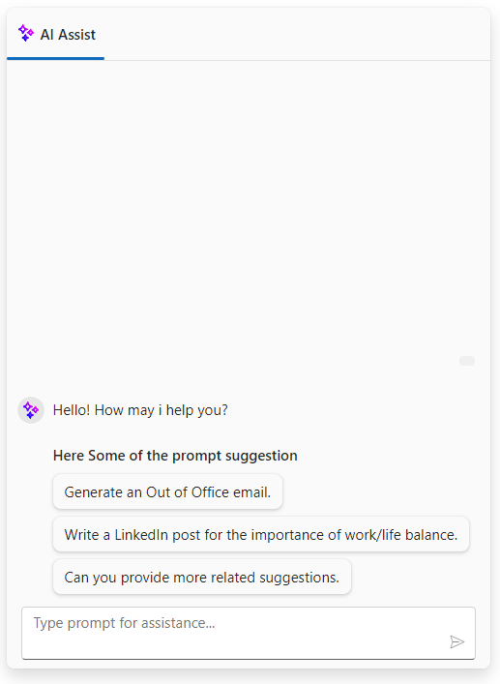

SYNCFUSION Essential Studio 2024 Volume 3
September 2024
New AI Assist component
Built-in support for predefined toolbar items, including copy, edit, and like/unlike options for prompts and responses.
Support for prompt suggestions with customization options.
Ability to execute custom commands through toolbar options.
Templating support for prompts, responses, and more.
Extensive customization options for creating personalized views in addition to the built-in assist view.
syncfusion.com/products/roadmap/blazor-components
Copyright © 2024 Syncfusion, Inc. All rights reserved.

Slide 13
Blazor makes building
AI-powered web apps easy
Summary
Add AI features with .NET Smart Components
Leverage the .NET AI ecosystem

Slide 14



Resources
aka.ms/dotnet/smart-components
telerik.com/blazor-ui
.NET Smart Components
Progress Telerik Blazor components
github.com/dotnet/ai-samples
devexpress.com/blazor
.NET AI samples
DevExpress Blazor components
github.com/dotnet/eShopSupport
syncfusion.com/blazor
eShop Support sample
Syncfusion Blazor components
github.com/danroth27/BlazorChatApp
blazor.net
Blazor chat app sample
Blazor home page

Slide 15

.NET Conf: Focus on AI
Learn more
aka.ms/dotnetFocusAI/Collection

